Slide 1
PROBABILITY & STATISTICS
Chapter 8: Interval Estimation of Parameters
LEARNING OBJECTIVES
Introduction
CI on μ of a N(μ, σ²): σ² known
CI on μ of a N(μ, σ²): σ² unknown
CI on μ of any distribution: large-sample
CI on σ² a normal distribution
CI for the proportion p: large-sample

Slide 2
INTRODUCTION
Introduction
A confidence interval estimate for is an interval of the form l ≤ μ ≤ u, where the endpoints l and u are computed from the sample data.
Because different samples will produce different values of l and u, these end-points are values of random variables L and U, respectively.
Suppose that we can determine values of L and U such that the following probability statement is true:
P(L ≤ μ ≤ U) = 1 - α
There is a probability of 1- α of selecting a sample for which the CI will contain the true value of μ

Slide 3
INTRODUCTION
Introduction
After we have selected the sample: X₁ = x₁, X₂ = x₂ , … , X_{n} = x_{n}, and computed l and u, the resulting confidence interval for μ is
l ≤ μ ≤ u
Lower-confidence limit
Upper-confidence limit
How to find the random variables L and U ?

Slide 4
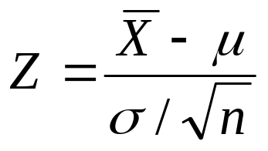
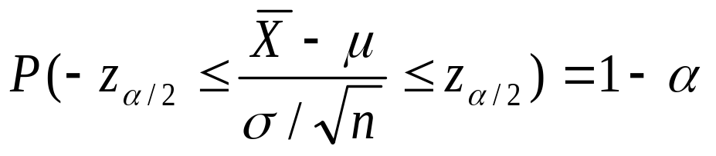
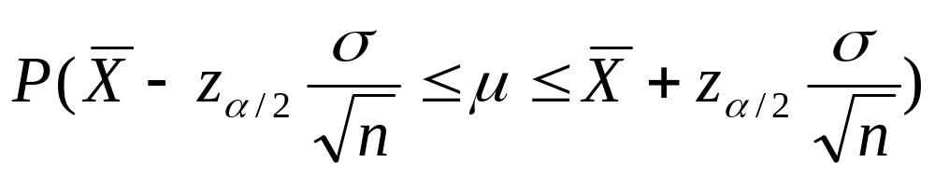
CI ON μ OF A N(μ, σ²): σ² KNOWN
Since ~ N (0, 1), we can find a real number
z_{α/2} such that
CI on µ of a N(µ, σ²): σ² Known
=NORMSINV(1- α/2)
or
L
U

Slide 5

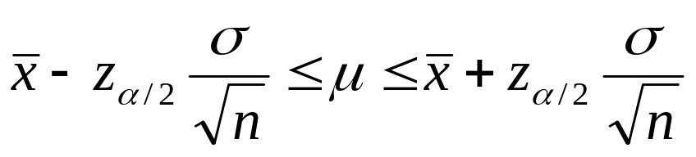
CI ON μ OF A N(μ, σ²): σ² KNOWN
CI on µ of a N(µ, σ²): σ² Known
Theorem
If is the sample mean of a random sample of size n from a normal population with known variance, (1 – α)-CI on μ is given by

Slide 6

CI ON μ OF A N(μ, σ²): σ² KNOWN
Example
CI on µ of a N(µ, σ²): σ² Known
A college admissions director wishes to estimate the mean age of all students currently enrolled. In a random sample of 20 students, the mean age is found to be 22.9 years. From past studies, the standard deviation is known to be 1.5 years, and the population is normally distributed. Construct a 90% confidence interval of the population mean age.
Solution: We have = 22.9; σ = 1.5; 1 – α =0.9;
α = 0.1 z_{α/2} = NORMSINV(1- 0.1/2) = 1.645

Slide 7
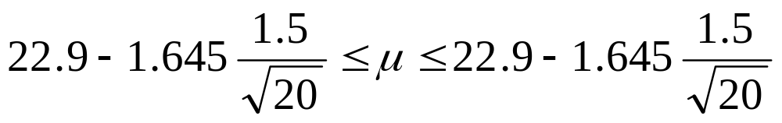

CI ON μ OF A N(μ, σ²): σ² KNOWN
Confidence interval:
CI on µ of a N(µ, σ²): σ² Known
or
22.3 ≤ μ ≤ 23.5
Point estimate
22.3
22.9
23.5
(
•
)

Slide 8
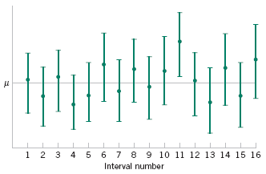
CI ON μ OF A N(μ, σ²): σ² KNOWN
CI on µ of a N(µ, σ²): σ² Known
Figure 8-1 Repeated construction of a confidence interval for μ.

Slide 9
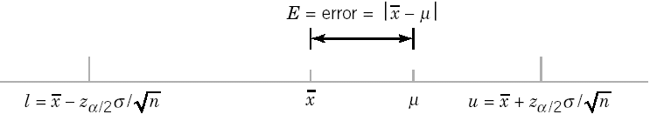
CI ON μ OF A N(μ, σ²): σ² KNOWN
Confidence Level and Precision of Estimation
CI on µ of a N(µ, σ²): σ² Known
The length of a confidence interval is a measure of the precision of estimation.
Figure 8-2 Error in estimating μ with .

Slide 10
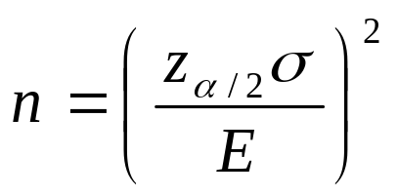
CI ON μ OF A N(μ, σ²): σ² KNOWN
Theorem Choice of Sample Size
CI on µ of a N(µ, σ²): σ² Known
If is used as an estimate of μ , we can be (1 – α)-confident that the error | - μ | will not exceed a specified amount E when the sample size is

Slide 11
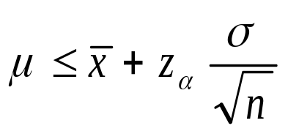
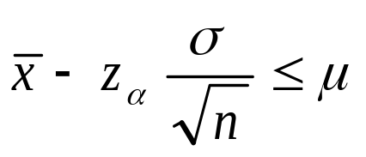
CI ON μ OF A N(μ, σ²): σ² KNOWN
CI on µ of a N(µ, σ²): σ² Known
Theorem One-Sided Confidence Bounds
A (1 – α) upper-confidence bound for μ is
A (1 – α) lower-confidence bound for μ is

Slide 12
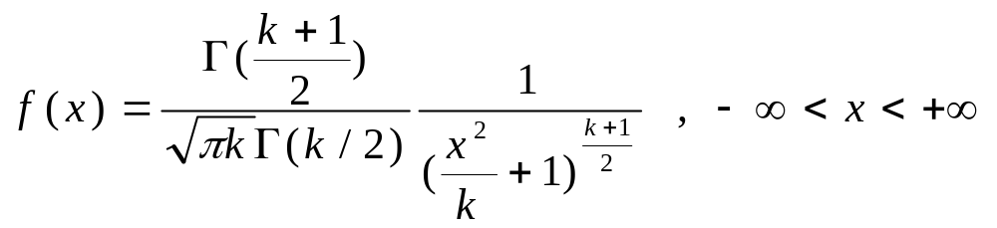
CI ON μ OF A N(μ, σ²): σ² UNKNOWN
Definition Student Distribution
The variable random X with probability density function
is called a Student variable random or t distribution with k degrees of freedom.
CI on µ of a N(µ, σ²): σ² Unknown

Slide 13
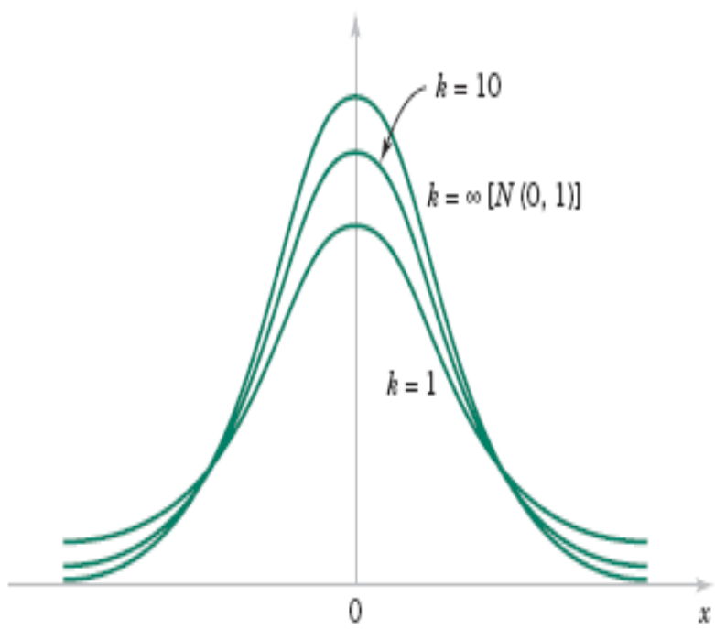
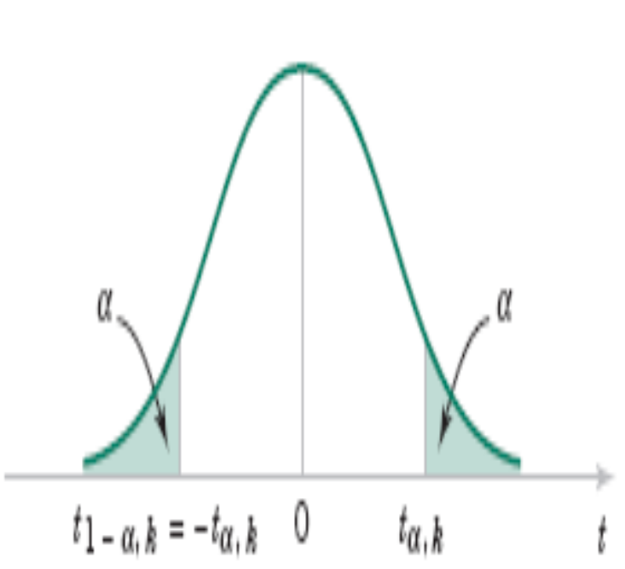
CI ON μ OF A N(μ, σ²): σ² UNKNOWN
CI on µ of a N(µ, σ²): σ² Unknown
Probability density functions of several t distributions.
Percentage points of the t distribution.

Slide 14
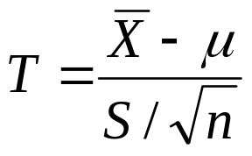
CI ON μ OF A N(μ, σ²): σ² UNKNOWN
Theorem t distribution
Let X₁, X₂, … , X_{n} be a random sample from a normal distribution with unknown mean μ and unknown variance σ². The random variable
has a t distribution with n - 1 degrees of freedom.
CI on µ of a N(µ, σ²): σ² Unknown

Slide 15
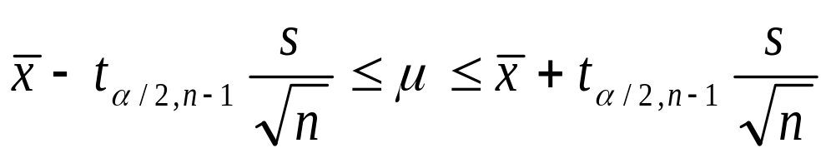
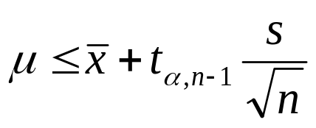
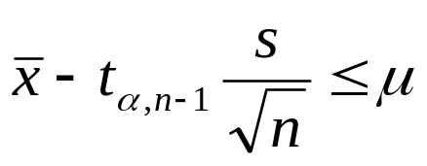
CI ON μ OF A N(μ, σ²): σ² UNKNOWN
Theorem
If and s are the mean and standard deviation of a random sample from a normal distribution with unknown variance σ²,
A (1 – α)-percent confidence interval on μ is given by
A (1 – α) upper-confidence bound for μ is
A (1 – α) lower-confidence bound for μ is
CI on µ of a N(µ, σ²): σ² Unknown
=TINV(α,n-1)

Slide 16

CI ON μ OF A N(μ, σ²): σ² UNKNOWN
Example
An article in the journal Materials Engineering describes the results of tensile adhesion tests on 22 U-700 alloy specimens. The load at specimen failure is as follows:
19.8 10.1 14.9 7.5 15.4 15.4 15.4 18.5 7.9 12.7 11.9 11.4 11.4 14.1 17.6 16.7 15.8 19.5 8.8 13.6 11.9 11.4
Find a 95% CI on μ.
CI on µ of a N(µ, σ²): σ² Unknown
Solution: We have = 13.71 and s = 3.55
α = 1- 0.95 = 0.05; n = 22 t_{α/2,n-1}= TINV(0.05,21) = 2.08
A 95% CI on μ is

Slide 17
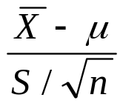
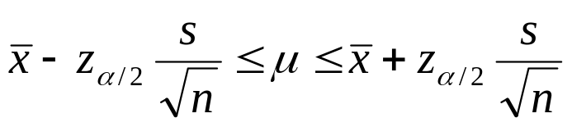
ARBITRARY DISTRIBUTION: A LARGE-SAMPLE
Theorem
When n is large, the quantity
has an approximate N (0, 1). Consequently,
is a large sample confidence interval for μ, with confidence level of approximately (1 – α).
n ≥ 40
CI on µ of arbitrary distribution

Slide 18
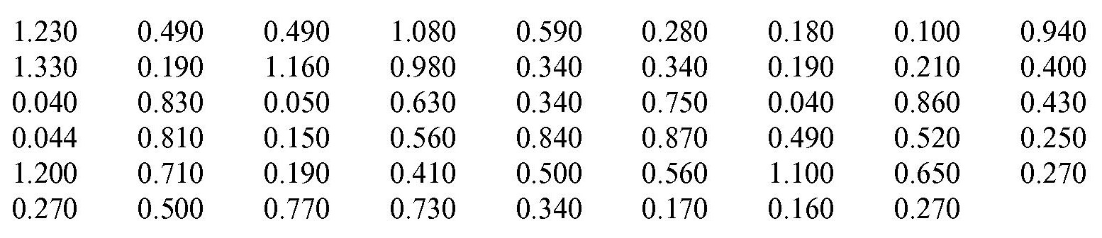
ARBITRARY DISTRIBUTION: A LARGE-SAMPLE
Example
A sample of fish was selected from 53 Florida lakes and mercury concentration in the muscle tissue was measured (ppm). The mercury concentration values are
Find an approximate 95% CI on μ.
CI on µ of arbitrary distribution
Solution: We have = 0.5250 and s = 0.3486
α = 1- 0.95 = 0.05; z_{α/2}= 1.96

Slide 19
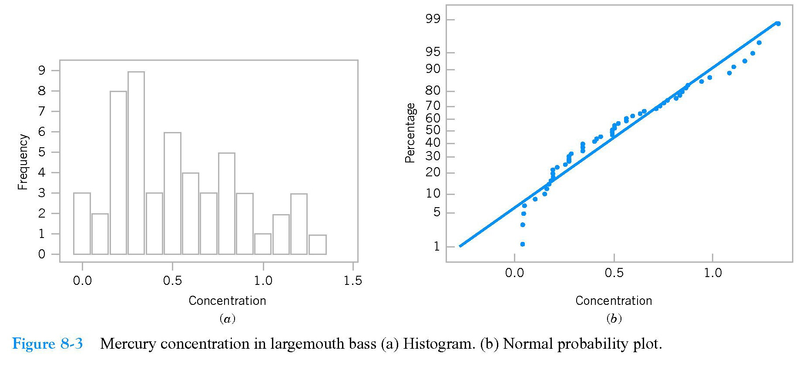
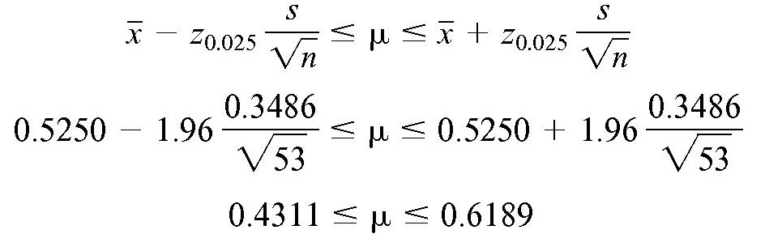
ARBITRARY DISTRIBUTION: A LARGE-SAMPLE
Distribution of mercury concentration is not normal
CI on µ of arbitrary distribution
Because n > 40, the approximate 95% CI on is

Slide 20
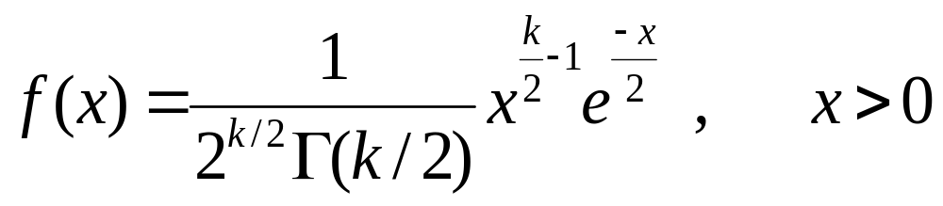
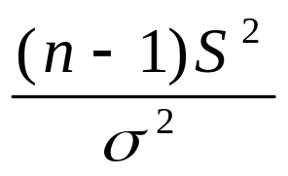
CI ON σ² OF A NORMAL
Definition Chi-square Distribution
The variable random X with probability density function
is called a χ² variable random with k degrees of freedom
Theorem
CI on σ² of a Normal
The random variable
has a χ² distribution with n -1 degrees of freedom.

Slide 21
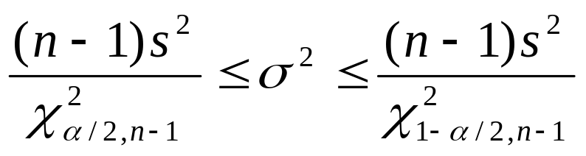
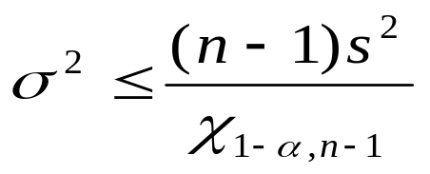
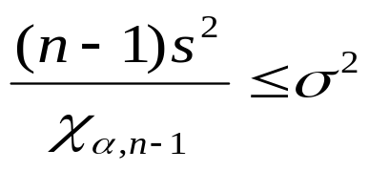
CI ON σ² OF A NORMAL
Theorem
A (1 – α)-percent confidence interval on σ² is given by
A (1 – α) upper-confidence bound for σ² is
A (1 – α) lower-confidence bound for σ² is
=CHIINV(1- α/2,n-1)
CI on σ² of a Normal

Slide 22
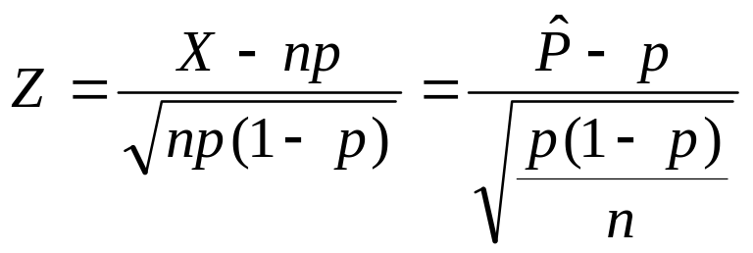
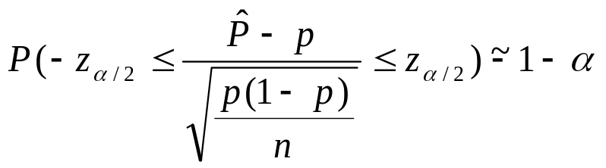
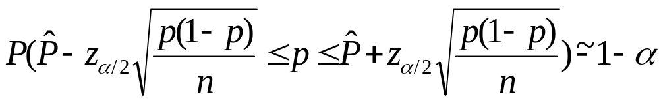
CI FOR p: A LARGE-SAMPLE
Theorem Normal approximation
If n is large, the distribution of
is approximately N (0, 1).
We can find z_{α/2} such that
or
CI for p

Slide 23

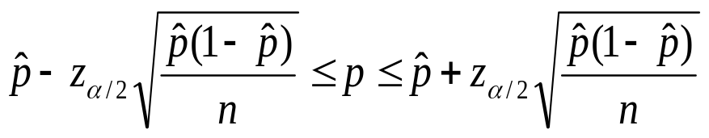
CI FOR p: A LARGE-SAMPLE
Theorem CI for p
Let is a point estimation for the proportion p of the population based on a random sample of size n, an approximate (1 – α)-confidence interval on p is
Remark: n >5 and n(1- ) > 5
CI for p

Slide 24
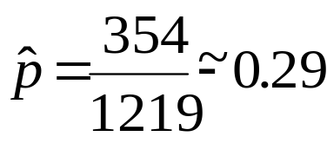


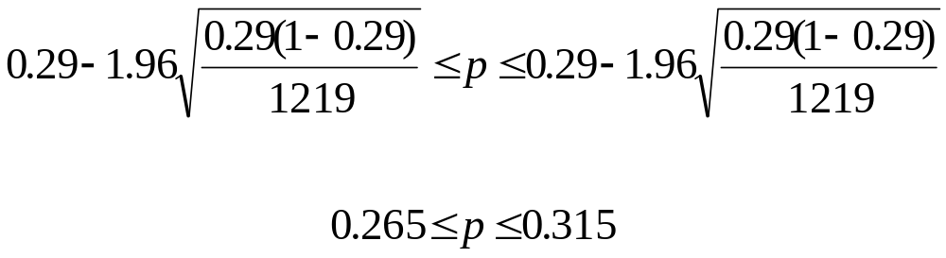
CI FOR p: A LARGE-SAMPLE
Example
In a survey of 1219 U.S. adults, 354 said that their favorite sport to watch is football. Construct a 95% confidence interval for the proportion of adults in the United States who say that their favorite sport to watch is football.
Solution: The point estimation for p:
Because and , a 95% CI for p is:
CI for p

Slide 25
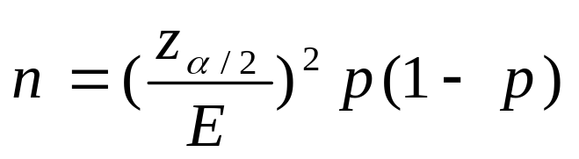
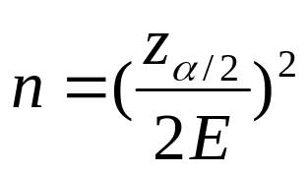
CI FOR p: A LARGE-SAMPLE
Theorem Choice of Sample Size
If is used as an estimate of p , we can be (1 – α)-confident that the error | - p | will not exceed a specified amount E when the sample size is
An upper bound on n is given by
≤1/4
CI for p

Slide 26
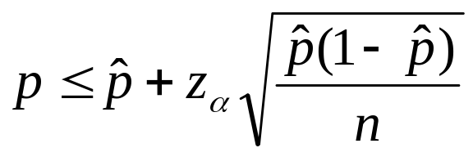
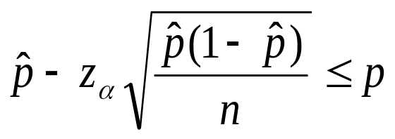
CI FOR p: A LARGE-SAMPLE
Theorem One-Sided Confidence Bounds
A (1 – α) upper-confidence bound for p is
A (1 – α) lower-confidence bound for p is
CI for p

Slide 27
SUMMARY
We have studied:
1.CI on μ of a N(μ, σ²): σ² known
2. CI on μ of a N(μ, σ²): σ² unknown
3. CI on μ of any distribution: large-sample
4. CI on σ2 a normal distribution
5. CI for the proportion p: large-sample
Homework: Read slides of the next lecture.
Summary

